Slide 1
Prenatal Diagnosis of Congenital Heart Disease- Where Are We?
Nithya Swaminathan, MD
Division of Pediatric Cardiology
Children’s Hospital Colorado, CO
Mishella Perez BS, RDMS, RDCS,
Division of Maternal Fetal Medicine
Scripps Health, San Diego, CA
Contributors: Heather Sun, MD- Rady Children’s, San Diego, CA
Jenna Keelan, MD- Children’s Health, Dallas, TX
Neeta Sethi, MD- Duke Children’s, Durham, NC
Lisa Zuckerwise, MD- MFM, UVA Health, VA

Slide 2




Objectives
Assess prenatal diagnostic rates for congenital heart disease (CHD)
Assess barriers to prenatal referrals
Propose a pathway to improve the diagnostic rates
Future scope and vision

Slide 3
Importance of Prenatal Detection of Congenital Heart Disease
Congenital heart disease (CHD) is the most common type of birth defect and the most common cause of infant mortality
Major forms of CHD can be detected at an 18-20 week anatomy scan
Prenatal detection of CHD can have a significant impact on perinatal and postnatal outcomes
Effective screening of CHD prenatally should be a public health priority

Slide 4




Benefits to the Neonate
Helps with delivery planning. Decreased need for pre op mechanical ventilation, antibiotics, cardiac catheterization and emergent surgeries
Decreases delay in diagnosis
Detection of other non cardiac anomalies
Significant impact on perinatal and postnatal outcomes
Decreases neonatal mortality
Notes:
Studies have shown a reduction in mortality and morbidity with specific congenital heart lesions such as hypoplastic left heart syndrome (HLHS), coarctation of the aorta and transposition of the great arteries²

Slide 5



Benefits to the Family
Allows family time to learn, plan and prepare
Opportunity for education and counseling, comprehensive diagnostic evaluation, decision-making, possible fetal therapy, multidisciplinary coordination of care, and specialized delivery planning
Fewer surprises in the delivery room

Slide 6




Benefits to the Medical Team
Plan for delivery and postnatal care
Gather the best team and be prepared
Determine the right place for delivery
Non cardiac anomalies- coordinate care with other teams

Slide 7
Incidence of CHD
1% Baseline Risk
1 in every 4 babies with CHD have critical CHD
1 per 100 live births
>3% Risk
Fetal Echo recommended when prenatal screening estimates >3% risk of CHD

Slide 8
American Society of Echocardiography Revised Fetal Echocardiogram Guidelines, July 2023
Fetal Echocardiogram Indications

Slide 9
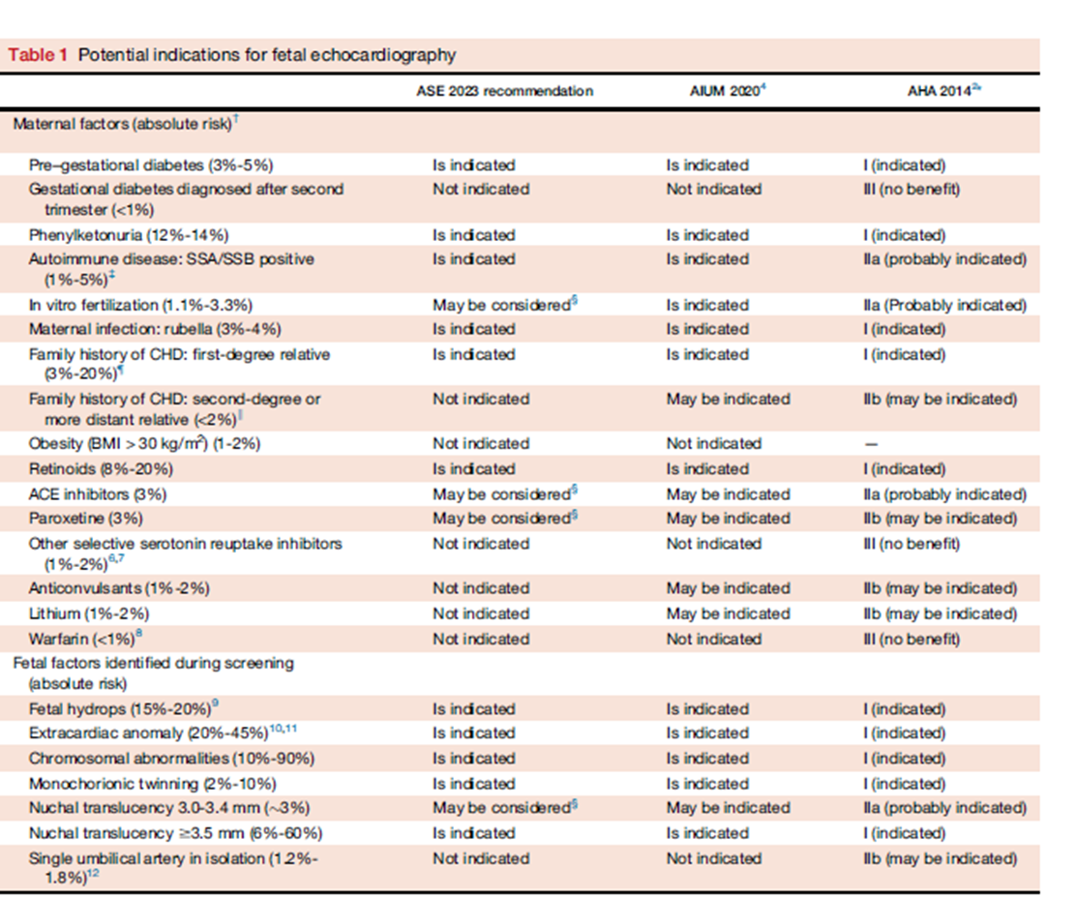
Fetal Echocardiogram Indications
Leading reason fetal cardiac evaluation is the referral for suspicion of a structural heart abnormality on obstetric US which results in a diagnosis of CHD in 40% to 50% of fetuses referred.
Notes:
Extracardiac anomaly is important because this is rarely talked about. i.e. the data showing increased risk of CHD many major structural anomalies and the decision whether to refer for fetal echo will depend on whether the sonologist performing the initial anatomy scan has experience/capability to do an adequate detailed anatomic survey. And considering risks of failure to detect CHD (i.e. different when delivering at remote community location as compared to planned birth at academic hosptial)

Slide 10
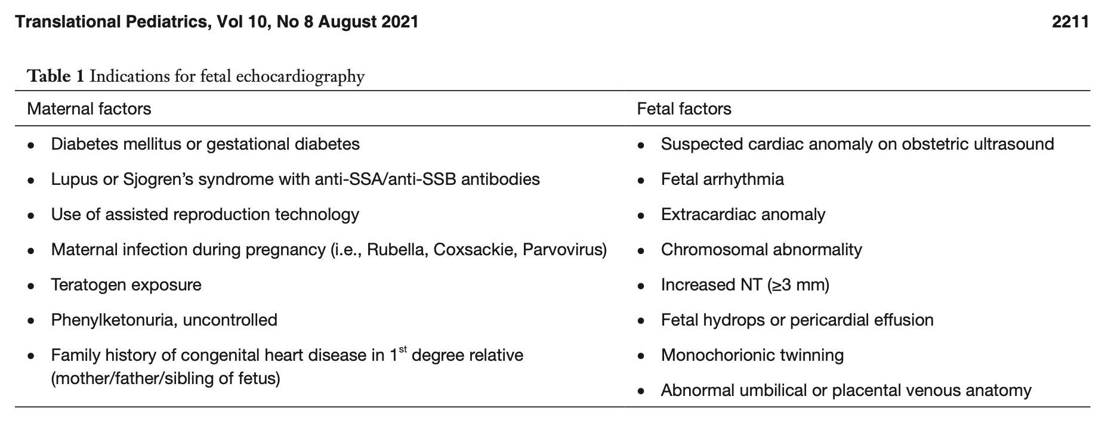
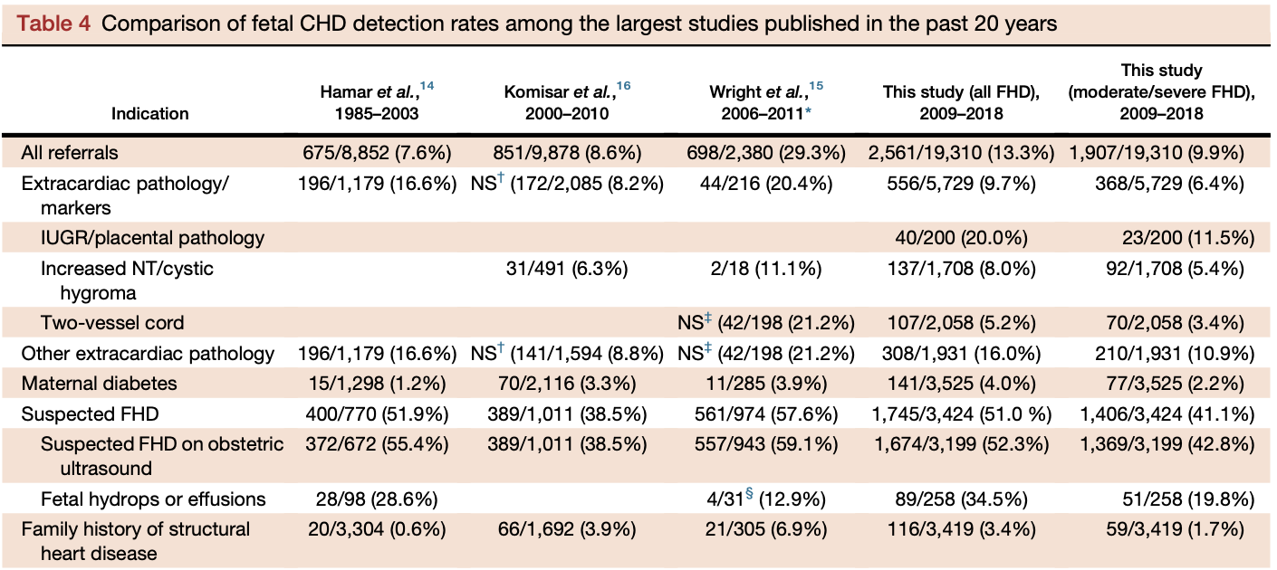
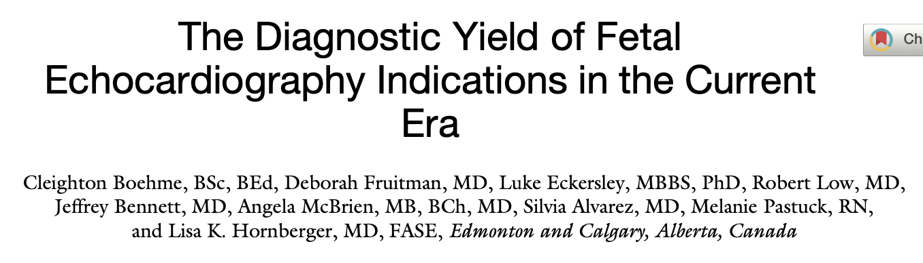
The majority of congenital heart disease occurs in otherwise
LOW RISK PREGNANCIES
Notes:
With all the reasons a pregnant mother should get a fetal echocardiogram, why were prenatal detection rates not adequate?
* Now, we all know there is a long list of both maternal and fetal indications in which a fetal echocardiogram is recommended to evaluate for CHD in pregnancies at higher risk.... MOST women carrying a baby with congenital heart disease will not have a reason to get a fetal echocardiogram OTHER THAN THE ABNORMAL HEART *. 80% of referrals for suspected FHD had no other reason for referral highlights the importance of ultra- sound screening for the prenatal detection of CHD rather than referral based solely on being at risk for FHD

Slide 11
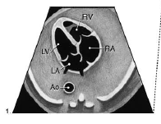
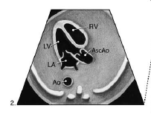
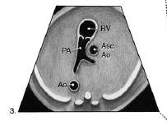
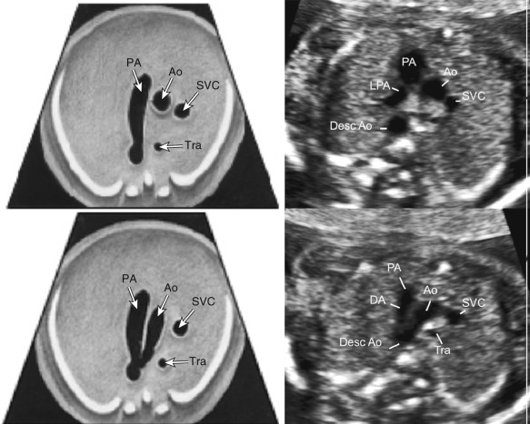
Guidelines Over the Past Decade
Pre-2013
2013
2019/2023
Outflow Tracts
4C View
Three Vessel View
Three Vessel Trachea View
ISUOG
AIUM/ISUOG
Education of obstetrical sonographers and practitioners who perform fetal anatomic screening is vital to increase referrals and prenatal detection of critical outflow tract anomalies.
Notes:
However, marginal improvement in prenatal diagnostic rates of CHD
(Sun HY, Proudfoot JA, McCandless RT (2018) Prenatal detection of critical cardiac outflow tract anomalies remains suboptimal despite revised obstetrical imaging guidelines. Congenit Heart Dis 13(5):748–756)

Slide 12
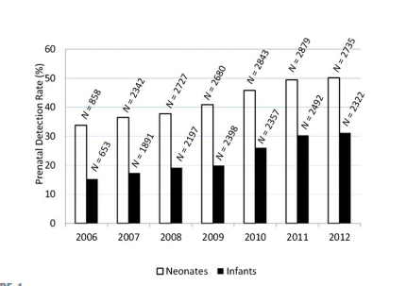
Rates of Prenatal Diagnosis
Despite the fact that 99% of women giving birth to babies with serious CHD had obstetric ultrasound examinations in the second or third trimester, national rates of prenatal detection remain low
(Quartermain et al. Pediatrics, 2015)
Notes:
Quartermain and colleagues (2015) analyzed prospectively collected congenital heart surgery database comprised of over 31,000 patients in 91 centers in the United States from 2006-2012 and found only a 34% prenatal detection rate
Increased every year, from 26% (2006) to 42% (2012) to 58% (2023)

Slide 13
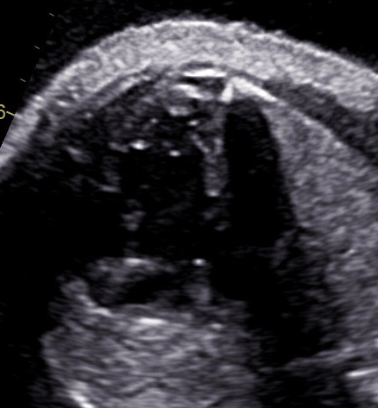
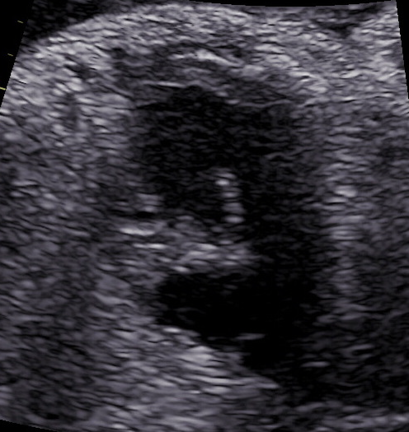
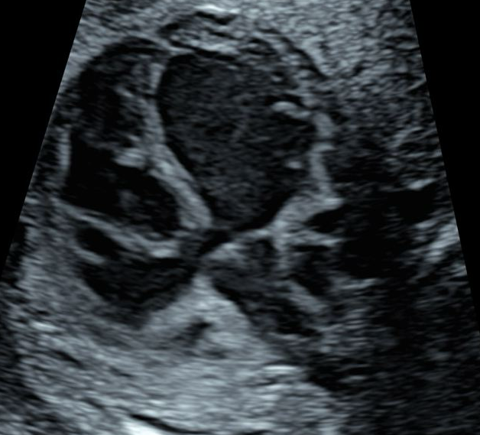
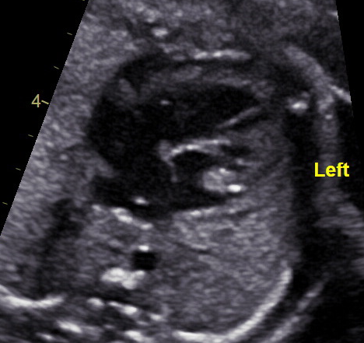
Rates of Prenatal Diagnosis
32%
56%
AV Canal Defect
Tricuspid Atresia
TOF
Cc - TGA

Slide 14
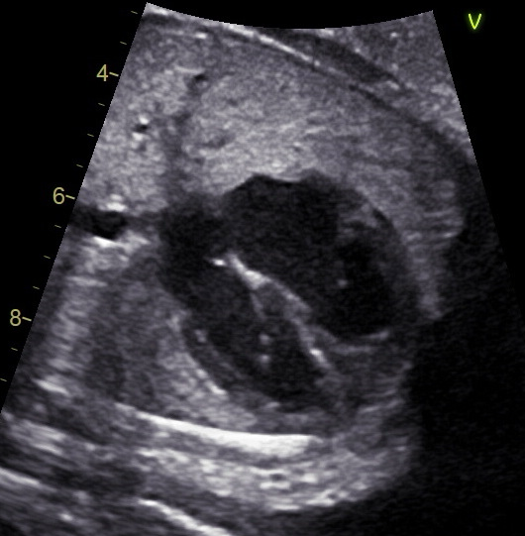
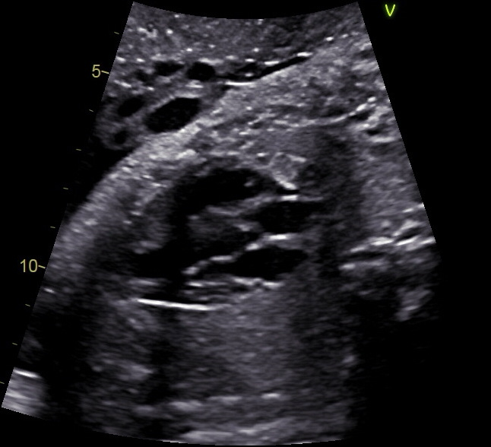
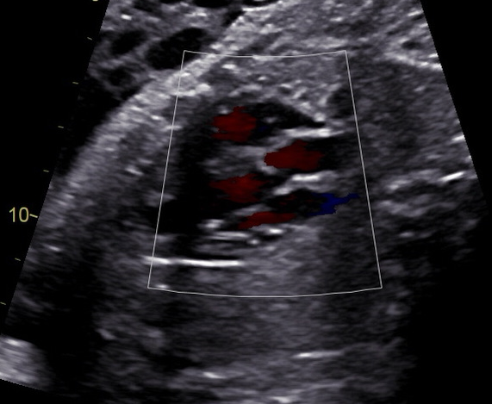
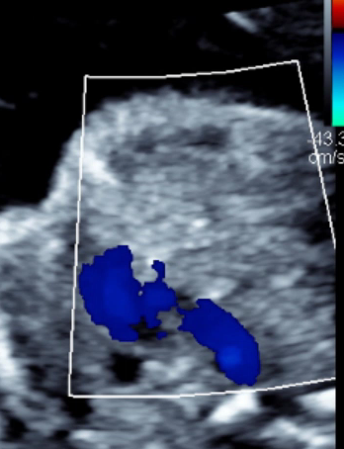
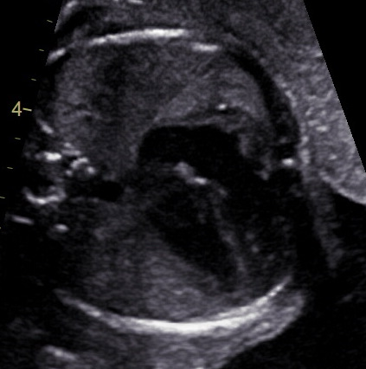
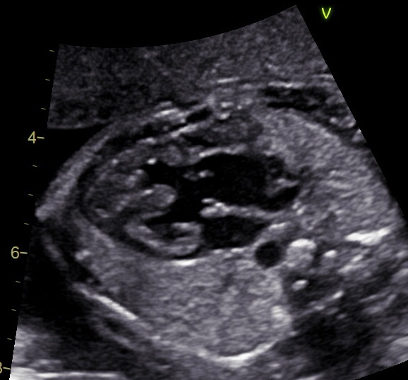
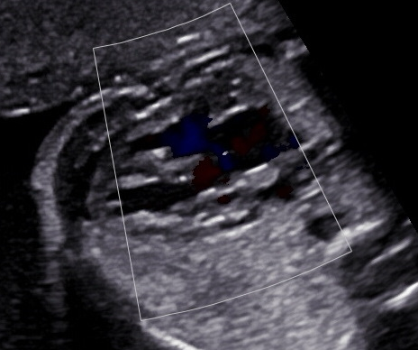
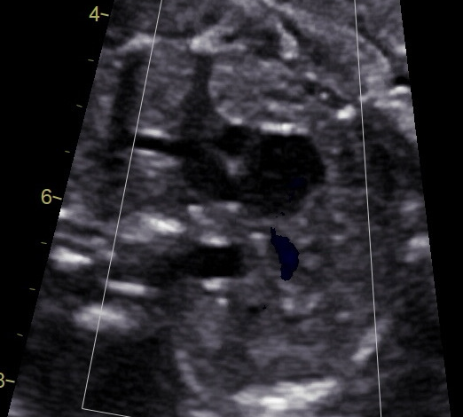
Normal appearing
4 Chamber View
ABNORMAL
Outflow Tracts
ABNORMAL
Three Vessel View
D-Transposition of the Great Arteries
Truncus Arteriosus
Notes:
These are NORMAL 4CV in fetuses with critical CHD – emphasize importance of additional views (great arteries crossing, 3V view and 3VT view)

Slide 15
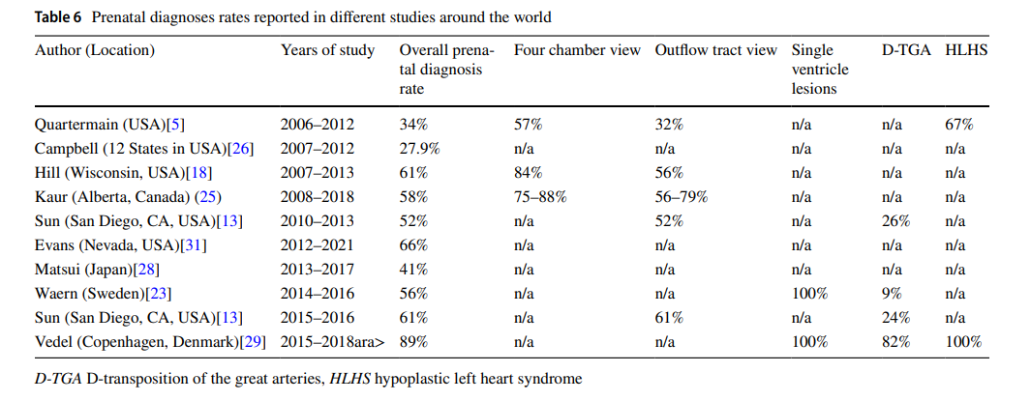
Rates of Prenatal Diagnosis in the Last Decade
Davtyan et al. Prenatal Diagnosis Rate of Critical Congenital Heart Disease Remains Inadequate with Significant Racial/Ethnic and Socioeconomic Disparities and Technical Barriers. Pediatric Cardiology, 2023
Notes:
Over the past decade, standard obstetric cardiac screening guidelines have expanded from a four-chamber view alone to include imaging of both outflow tracts ( ISUOG 2013) and the three vessel view (3VV) and three-vessel-and-trachea view (3VT) when technically feasible (AIUM, practice guidelines- 2019 and ISUOG 2023)
Kaur A, Hornberger LK, Fruitman D et al (2022) Trends in the prenatal detection of major congenital heart disease in Alberta from 2008 to 2018. J Obstet Gynaecol Can 44(8):895–900

Slide 16
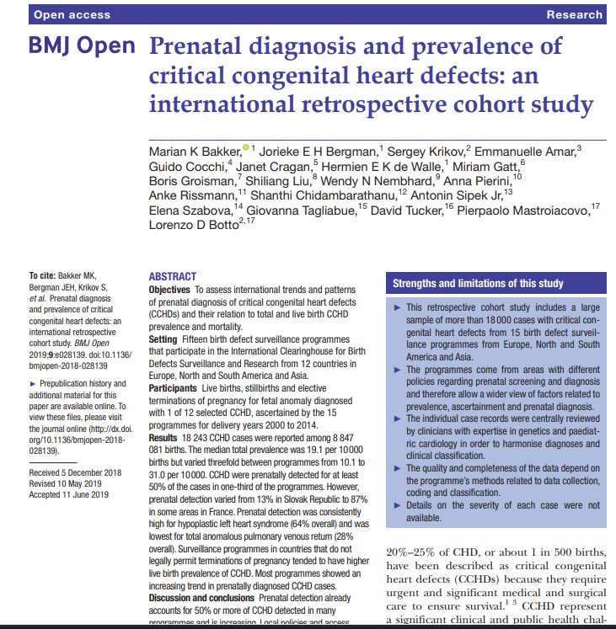
Notes:
Large retrospective cohort study is based on data from 15 birth defect surveillance programmes that are members of the International Clearinghouse for Birth Defects Surveillance and Research across 12 countries in Europe, North and South America and Asia
The study included cases (LBs, stillbirths (SBs) and TOPFAs, depending on programme) with 1 of 12 types of CCHD: hypoplastic left heart syndrome (HLHS), coarctation of the aorta (COA), aortic valve stenosis (AoS), tetralogy of Fallot (TOF), d-transposition of great arteries (DTGA), double outlet right ventricle, persistent truncus arteriosus (PTA), interrupted aortic arch (IAA), pulmonary valve atresia with intact ventricular septum, tricuspid valve atresia/hypoplastic right heart (TriA/HRH), single ventricle (SV) and total anomalous pulmonary venous return (TAPVR).

Slide 17
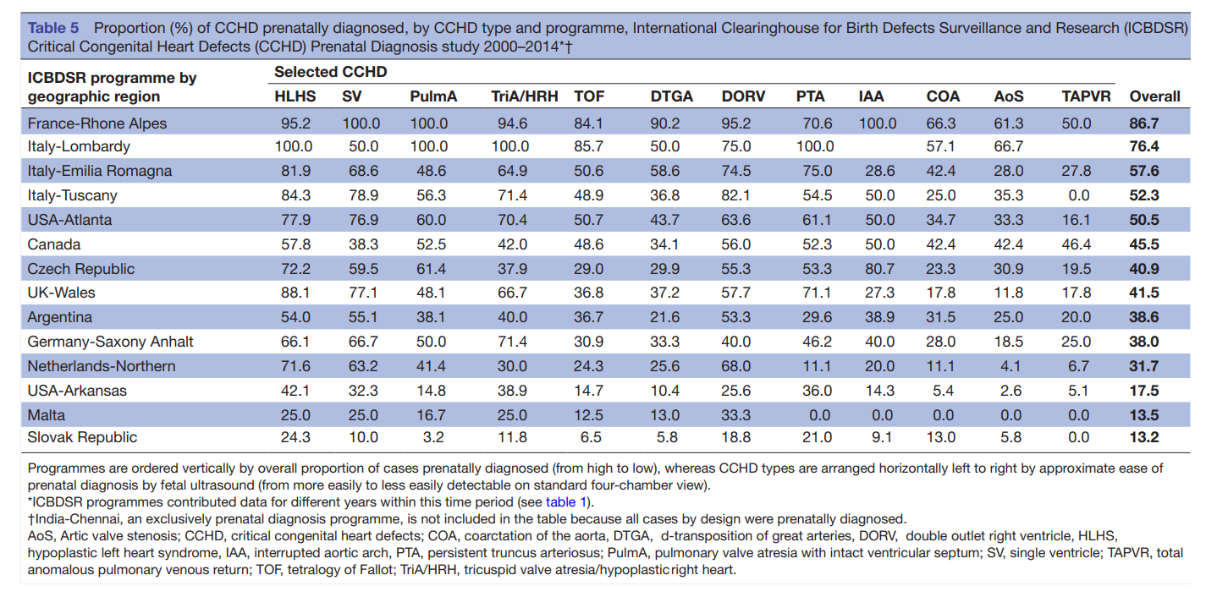
Rates of Prenatal Diagnosis

Slide 18
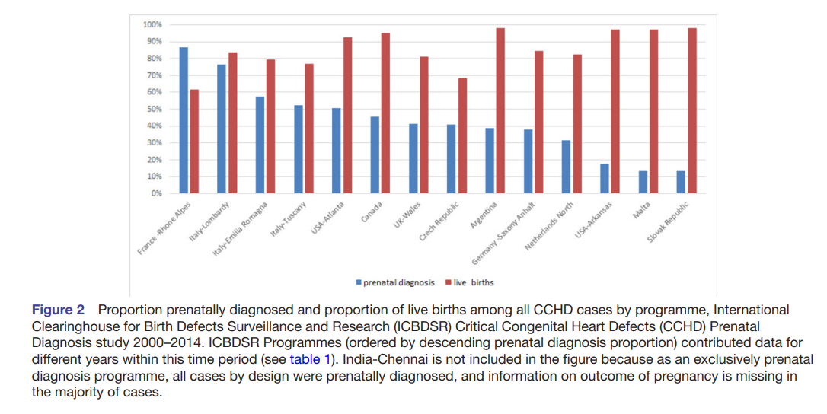
Rates of Prenatal Diagnosis

Slide 19
Barriers to Prenatal Detection of CHD
Socioeconomic Factors
Insurance, Race, Geographic Location
Image Optimization and Education of Frontline Sonographers
(Outflow tracts and 3VT views)
Barriers
Access to Trained Sonographers
Access to Perinatologists/Fetal Cardiologists

Slide 20
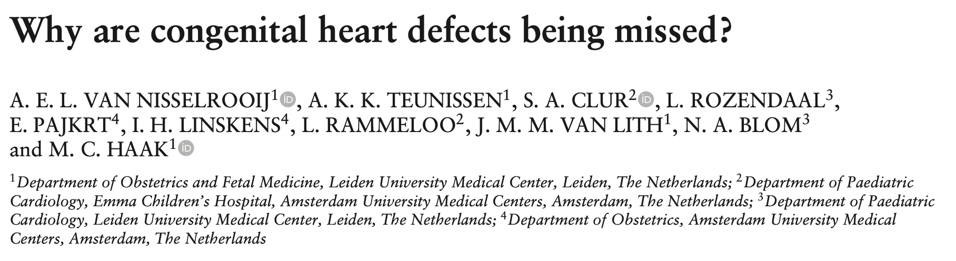
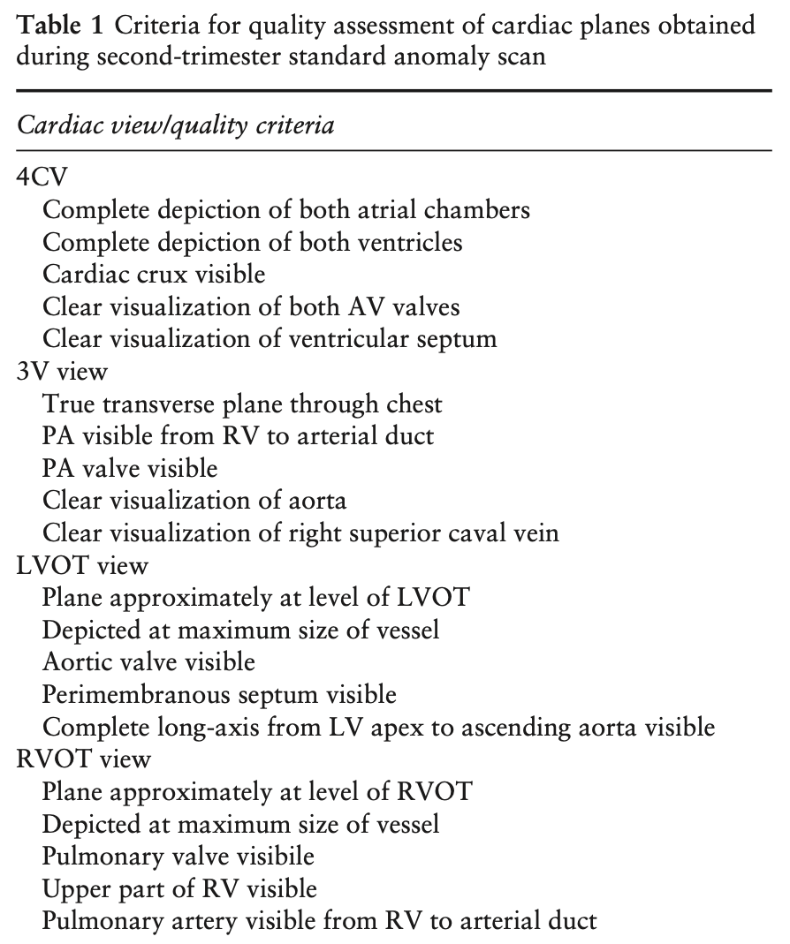
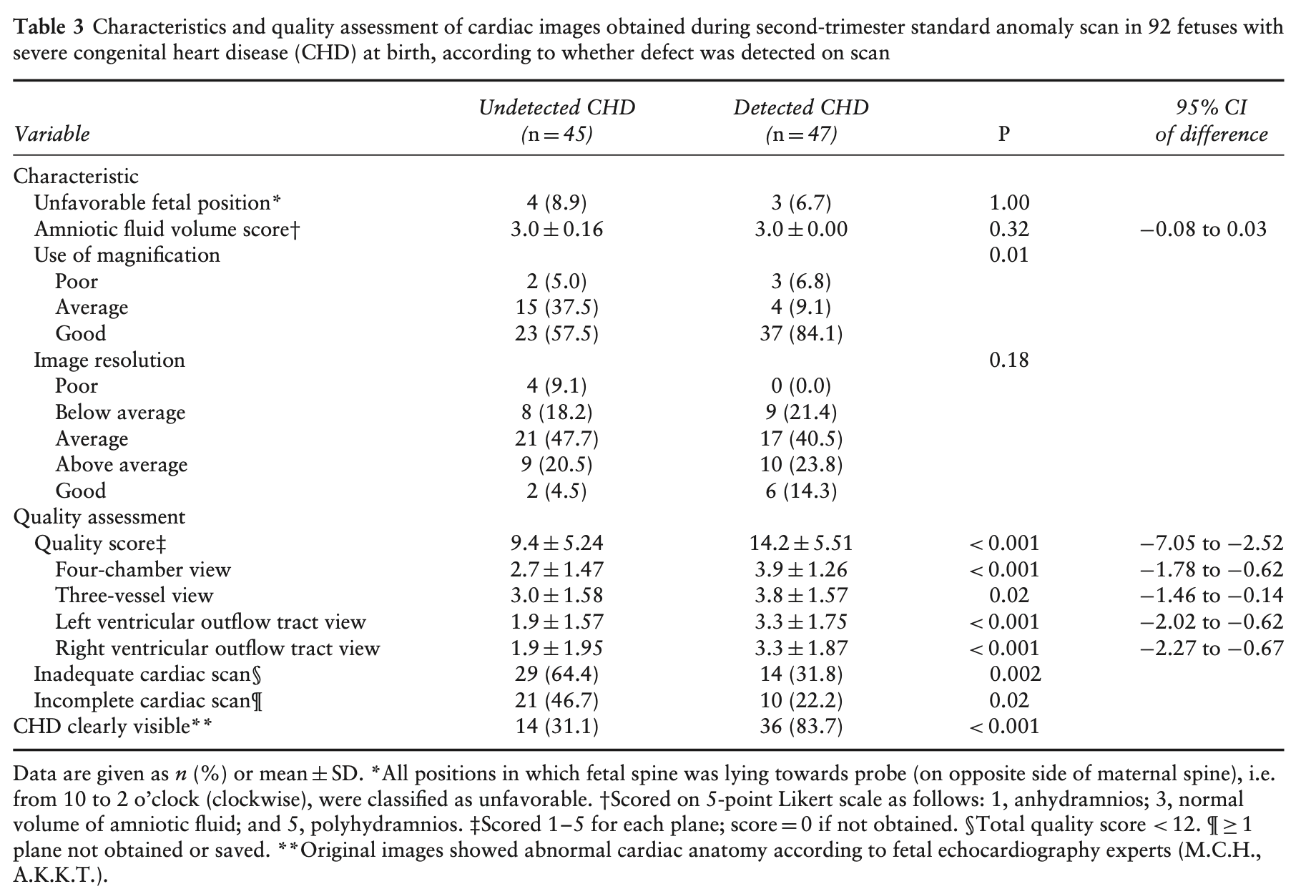


Ultrasound Obstet Gynecol 2020; 55: 747–757
Notes:
2015-2016 Netherlands – retrospective evaluation of second trimester anatomic scan images on patients with CCHD < 1 yo
Quality of cardiac images is important
Failure to recognize was also an important point in cases of CCHD
Unfavorable fetal position, AFI, image resolution was not different

Slide 21
FHS Education Webinar Link
Screening views and image optimization:

Slide 22
This highlights the continuing need for further education, training, and innovation to improve the accuracy of obstetrical scanning and to expand the availability of fetal echocardiography services nationally

Slide 23
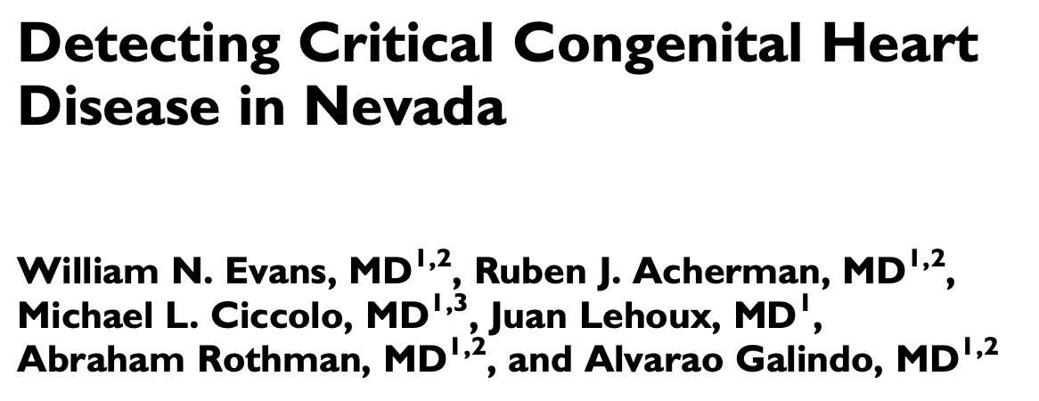



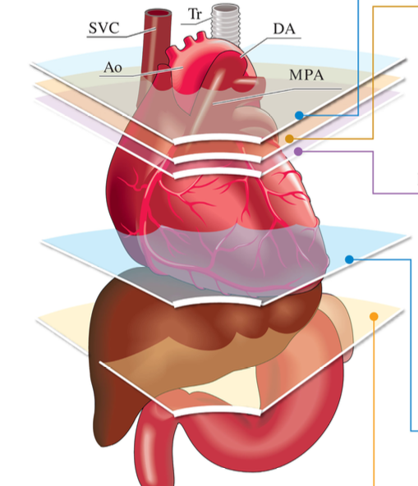

Ongoing educational programs
for OB and MFM sonographers
OB sonographer lectures
Five-axial view screening
On-site fetal cardiologists supervise all
fetal echocardiograms at all MFM clinics
Notes:
Successful efforts have been demonstrated - Role model example of multidisciplinary efforts to improve prenatal CHD diagnosis
OB and MFM sonographers are then well equipped to successfully screen for fetal cardiac disease across the state
7 fetal cardiologists provide coverage to 11 MFM offices throughout the state in 5 different groups with 40 MFM sonographers

Slide 24
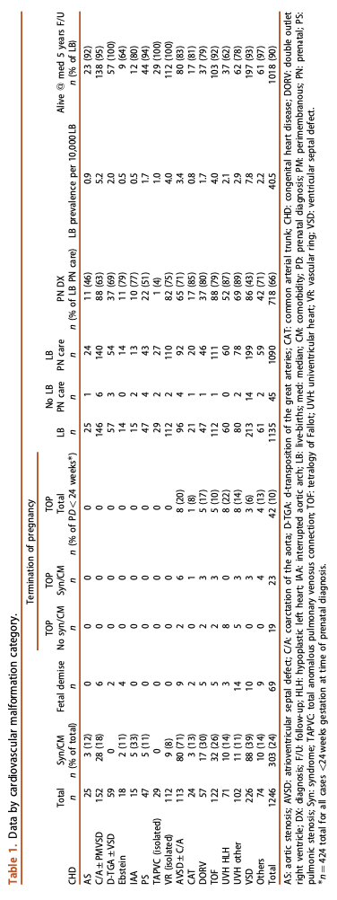
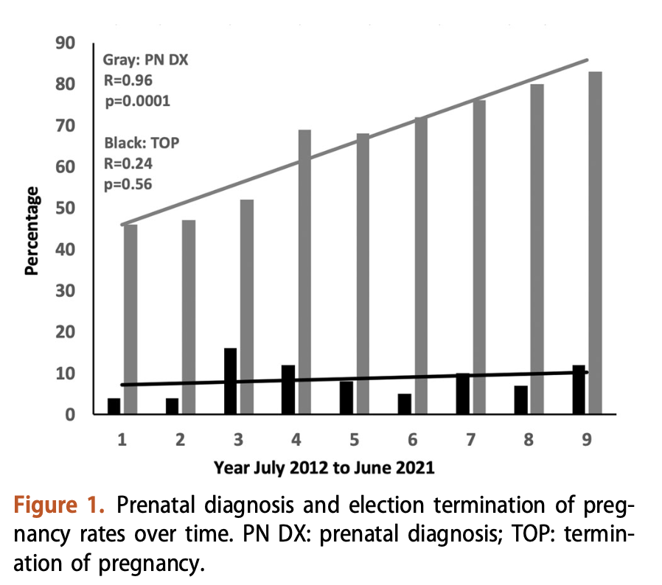
Evans et al. The Journal of Maternal-Fetal & Neonatal Medicine 2022, 35:25, 8761-8766.
82%
Prenatal Diagnosis Rate
45%
Notes:
significant congenital heart disease as those undergoing or pending cardiovascular surgery or inter-ventional cardiac catheterization between 0 and 24 months old
Abortion rate did not change and is legal in Nevada up to 24 weeks, so this is not a reflection on limited access or changing access in that state
4 in 1000 significant CHD
Overall 66% prenatal diagnosis – statistical increase from 45% in 2012 to 82% in 2021
In Nevada, despite a statistically significant increase in prenatal detection of significant congenital heart disease over time, termination of pregnancy rates did not increase. Nevertheless, those undergoing elective termination were more likely to have associated syndromes or comorbidities.

Slide 25

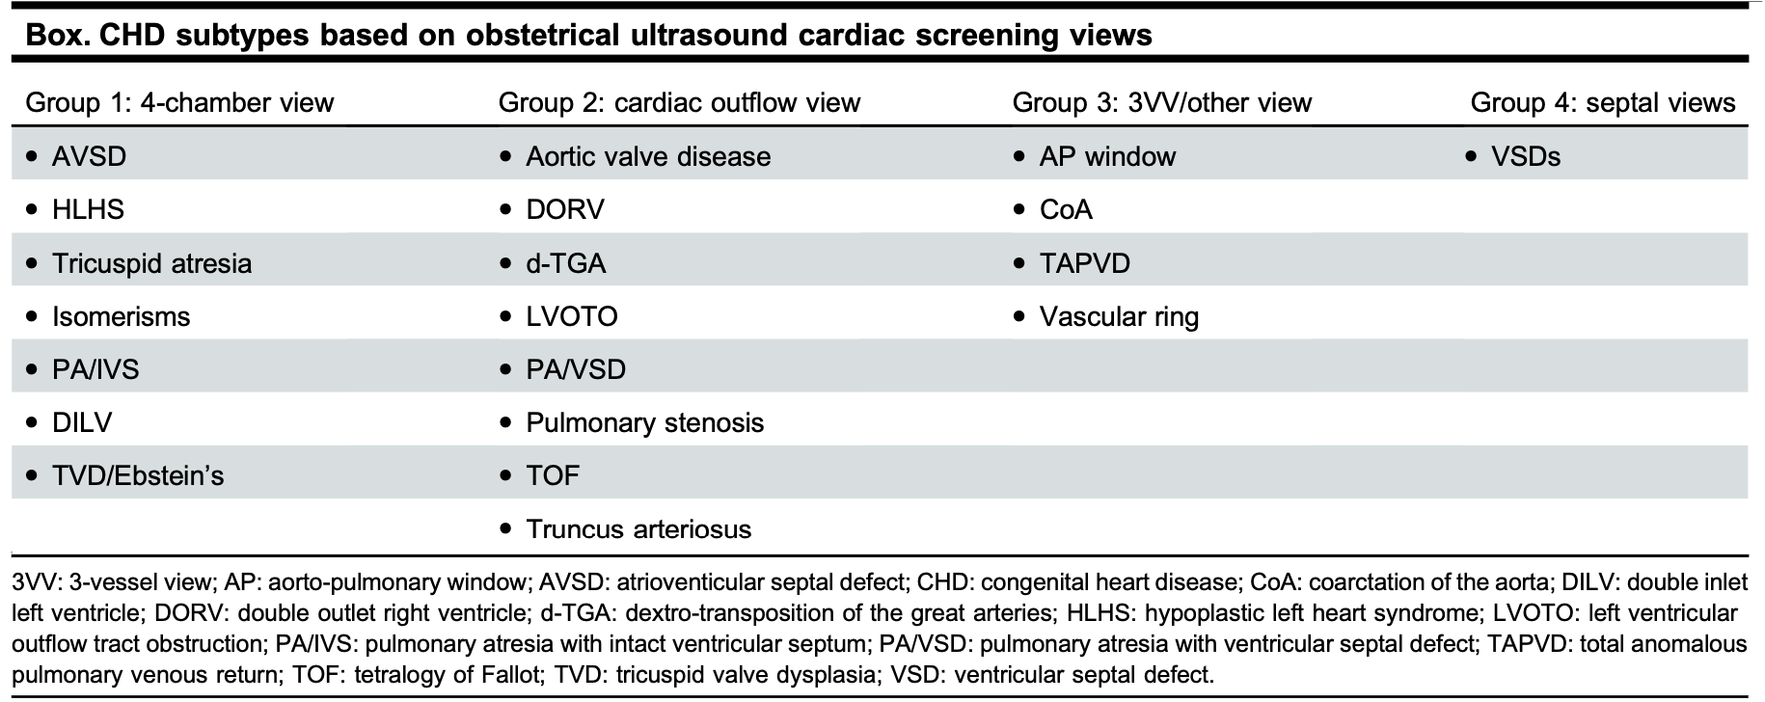
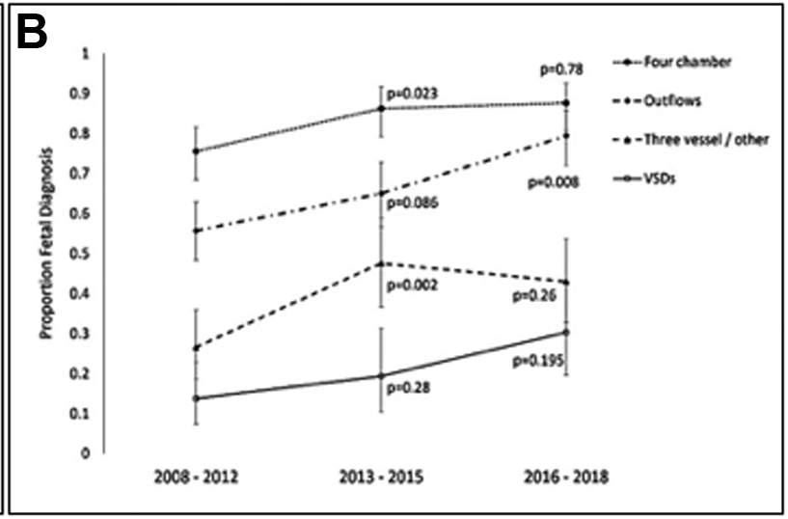
Kaur A, Hornberger LK, Fruitman D et al (2022). J Obstet Gynaecol Can 2022;44(8):895-900
20%
37%
66%
82%
58% of 1405 fetuses and infants
Prenatally Diagnosed CHD
66%
83%
2008-2012
2016-2018
Overall Prenatal Detection Rate
Notes:
Within 1st year of life
Prenatal Detection Rates –
Highest rates for AVSD, HLHS, DTGA, and TOF
Their results may be more encouraging… so improvement is possible with the right efforts at the primary care level

Slide 26
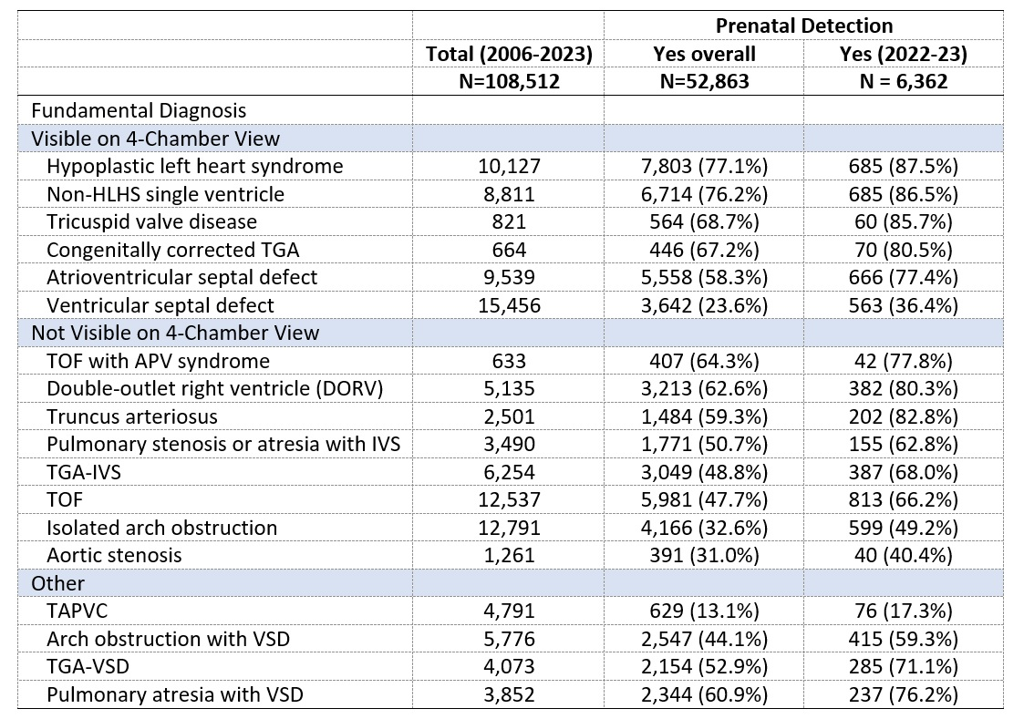
2024 STS Updated Data
Variation of prenatal detection of congenital heart disease in infants: updated analysis of the society of thoracic surgeons congenital heart surgery database
Ann Thoracic surgery, in press 2025. Riberio, E. Quartermain, M. , Jacobs, J. et. al.

Slide 27
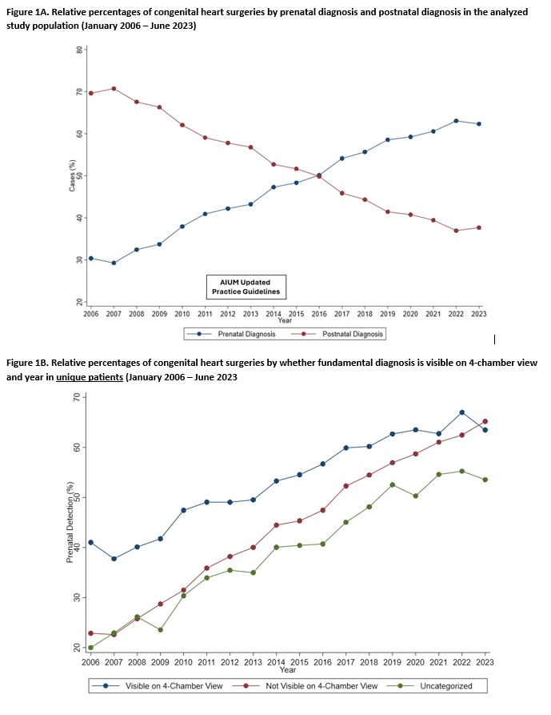
Ribeiro ER, Co-Vu J, Quartermain MD, Bonnell LN, Goldberg DJ, Brinkley LM, Husain SA, Peek GJ, Habib RH, Nelson JS, Bleiweis MS, Jacobs ML, Jacobs JP. Variation of Prenatal Detection of Congenital Heart Disease in Infants: Updated Analysis of The Society of Thoracic Surgeons Congenital Heart Surgery Database. Ann Thorac Surg. 2025 Aug 19:S0003-4975(25)00658-7. doi: 10.1016/j.athoracsur.2025.06.049. Epub ahead of print. PMID: 40892004.
Notes:
Prenatal detection rates of congenital heart disease (CHD) in patients requiring early surgical intervention have been suboptimal, with variability between geographic regions and across defect types. In 2013, obstetric screening ultrasound guidelines were updated, recommending the addition of outflow tract views to improve prenatal detection rates. The objective of this study was to evaluate prenatal detection rates before and after the introduction of outflow tract views in obstetric screening examinations.

Slide 28
Ribeiro ER, Co-Vu J, Quartermain MD, Bonnell LN, Goldberg DJ, Brinkley LM, Husain SA, Peek GJ, Habib RH, Nelson JS, Bleiweis MS, Jacobs ML, Jacobs JP. Variation of Prenatal Detection of Congenital Heart Disease in Infants: Updated Analysis of The Society of Thoracic Surgeons Congenital Heart Surgery Database. Ann Thorac Surg. 2025 Aug 19:S0003-4975(25)00658-7. doi: 10.1016/j.athoracsur.2025.06.049. Epub ahead of print. PMID: 40892004.
Notes:
The study included 108,512 patients at 123 centers. Prenatal detection rates of CHD continuously increased during the study time frame. Prenatal detection rates varied by region (43.6%-56.2%) and lesion type (13.1%-77.1%). Prenatal detection rates have increased for lesions not routinely detected on a 4-chamber view but visible on outflow tract views in comparison to those routinely detected on a 4-chamber view (P = .029). Overall improved but still less than 65-70% prenatal detection rates.

Slide 29




Future Pathways
Widespread Education
Including indications for fetal cardiology referral
Hands-On Sessions
Incorporating fetal cardiac views on screening ultrasound
Adaptation of the 3VV and 3VT view could pave the way toward increasing prenatal diagnosis rates of CHD
Creative Sonographer Training
Virtual Simulators
Robust Telemedicine Programs
For outreach centers to bridge the gap of social inequities
For collaboration with OBGYN colleges
Artificial Intelligence
To assist during screening OB ultrasounds for machine based learning strategies
Notes:
Equitable access to high-quality prenatal care, incorporation of comprehensive fetal cardiac views on screening ultrasound, and delivery planning at a tertiary (or quaternary) care center with maternal fetal medicine and CHD specialists are necessary cornerstones to improve both maternal and neonatal health in pregnancies complicated by fetal CHD.

Slide 30
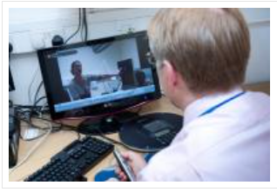
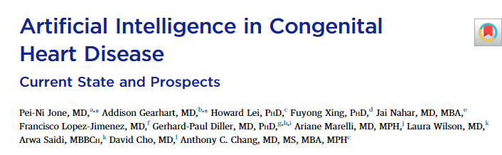
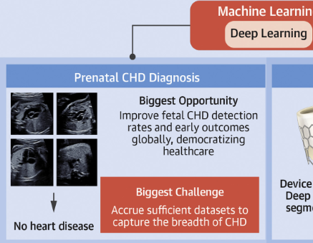
The Future…

Slide 31
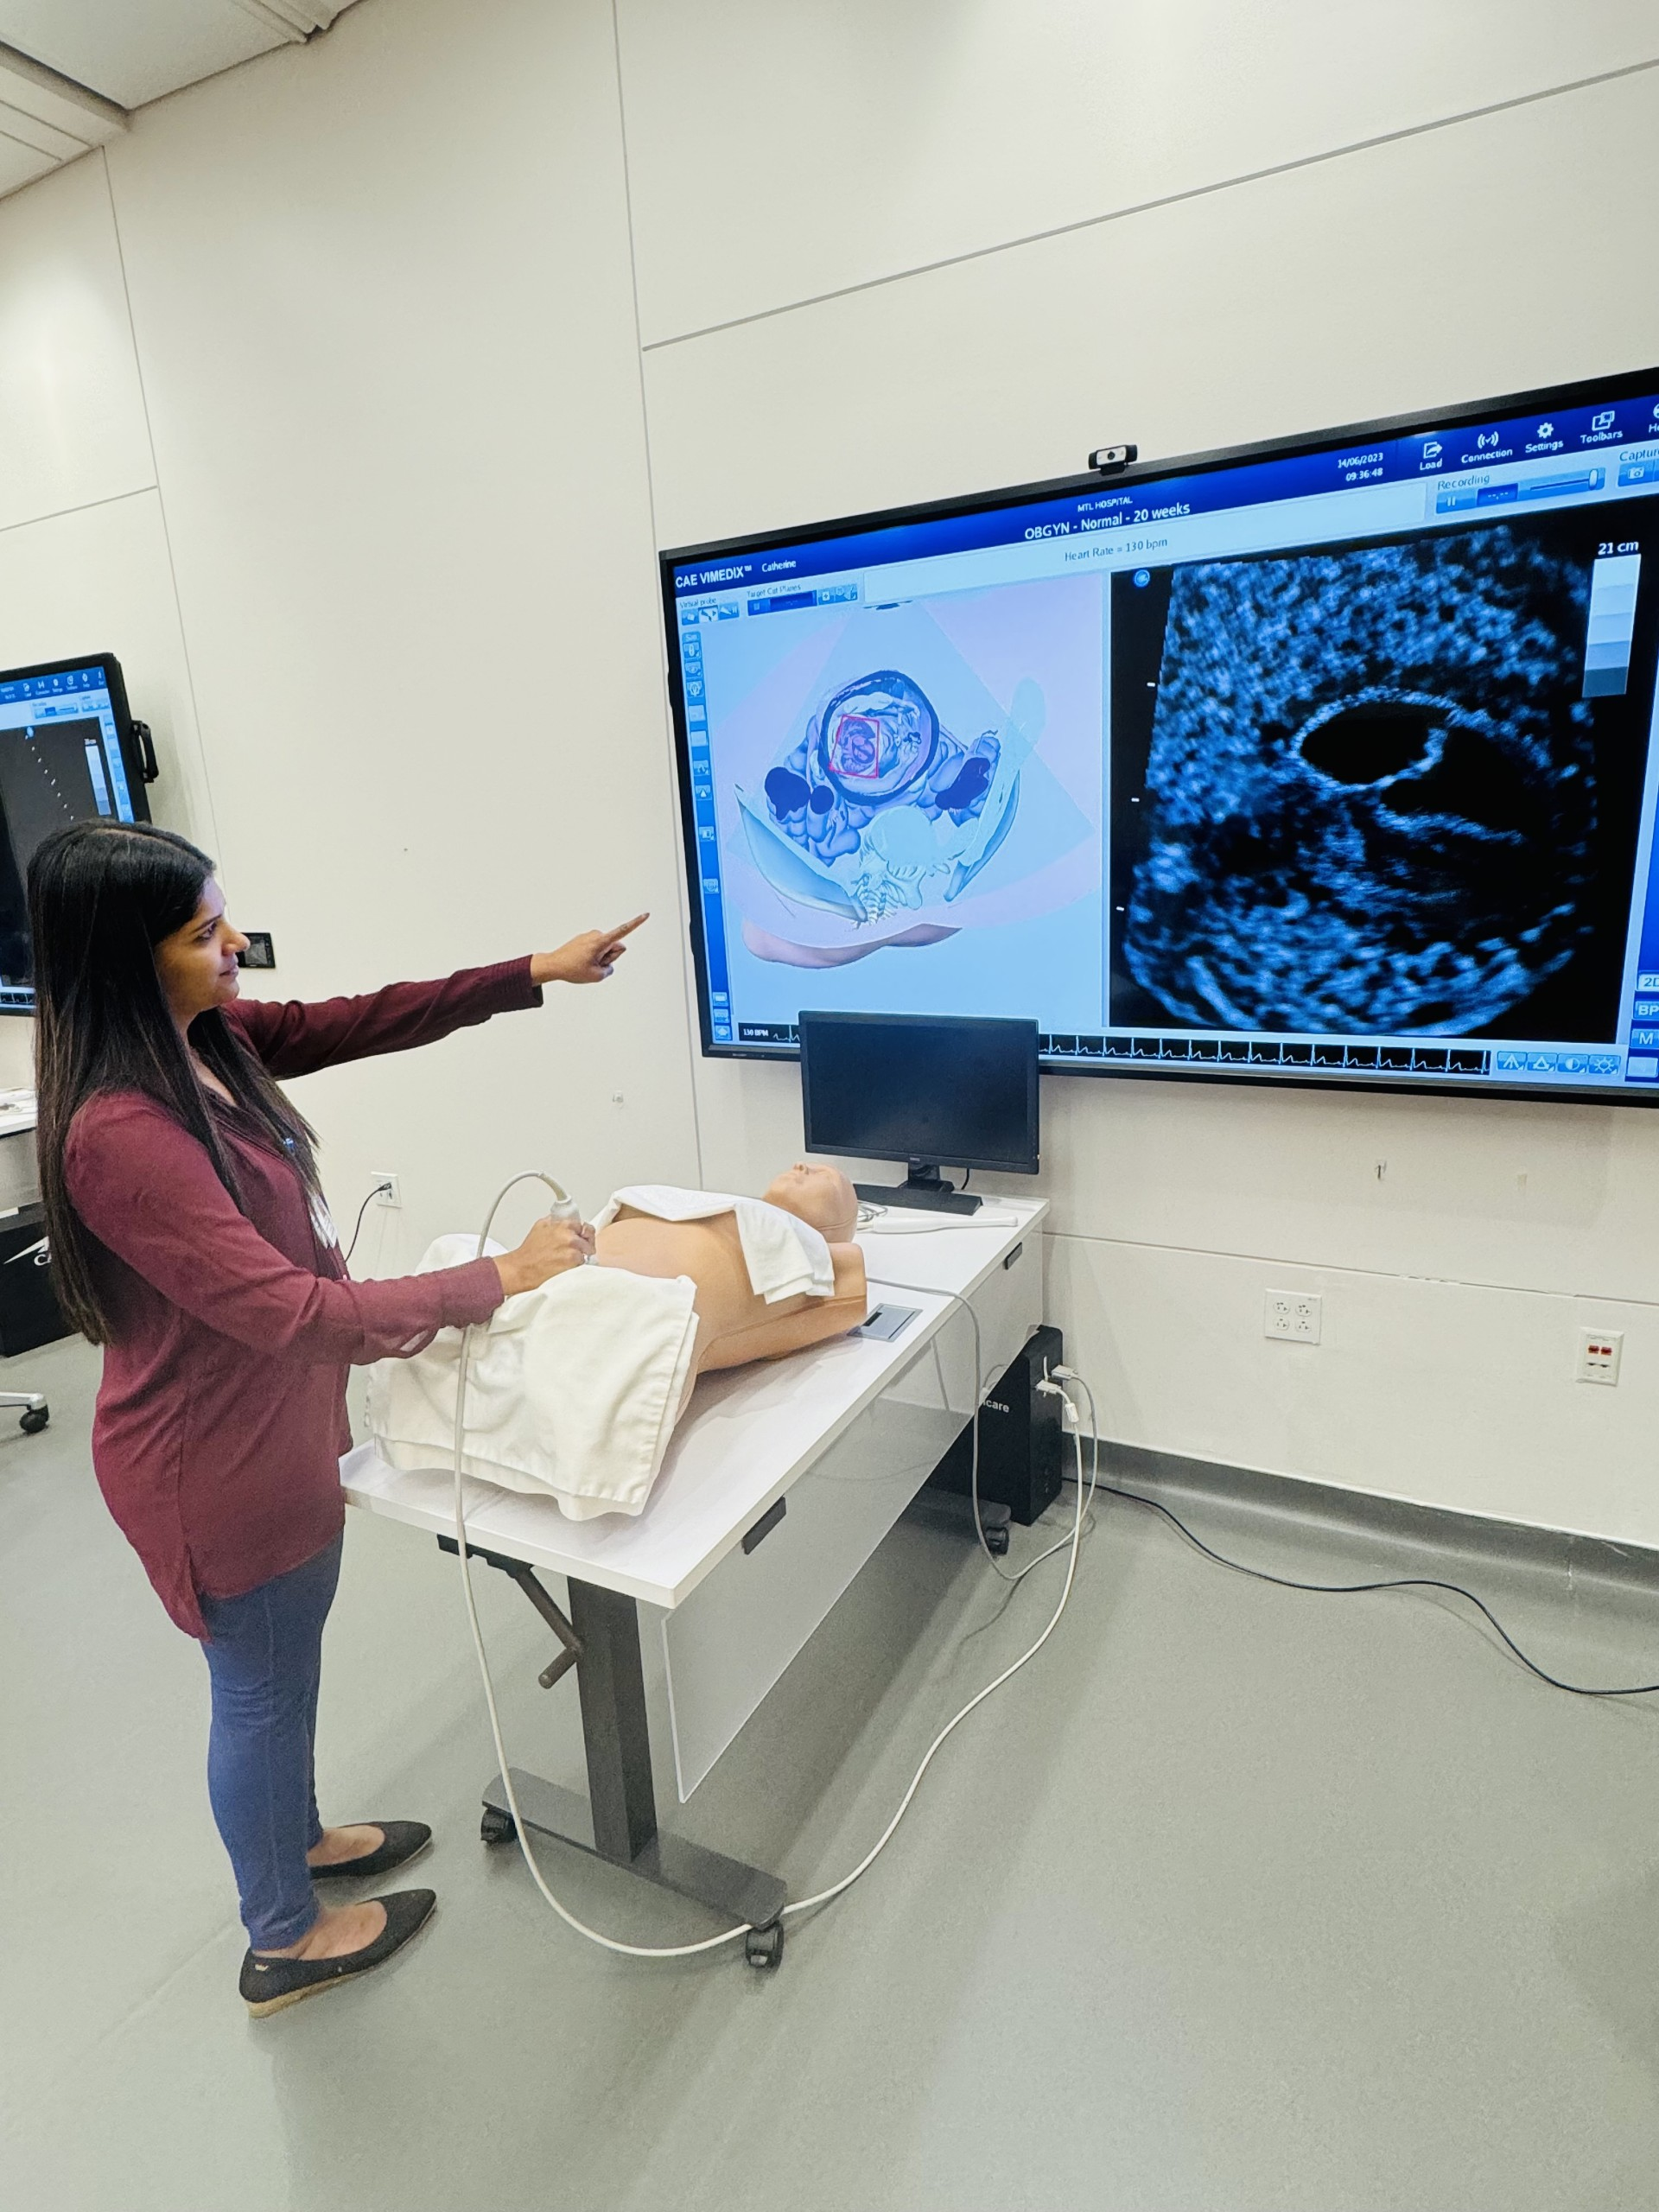
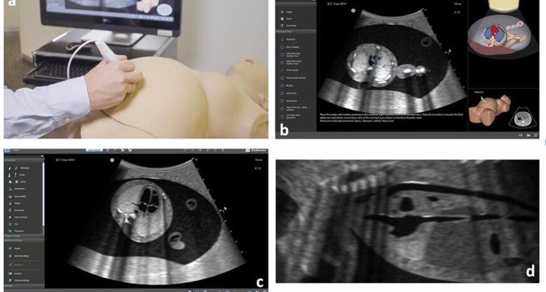
Virtual Simulators

Slide 32
References
Van der Linde D, Konings EE, Slager MA, Witsenburg M, Helbing WA, Takkenberg JJ, Roos-Hesselink JW. Birth prevalence of congenital heart disease worldwide: a systematic review and meta-analysis. J Am Coll Cardiol. 2011 Nov 15;58(21):2241-7. doi: 10.1016/j.jacc.2011.08.025. PMID: 22078432.
Campbell MJ, Lorch S, Rychik J et al (2021) Socioeconomic barriers to prenatal diagnosis of critical congenital heart disease. Prenat Diagn 41(3):341–346
Boehme C, Fruitman D, Eckersley L, Low R, Bennett J, McBrien A, Alvarez S, Pastuck M, Hornberger LK. The Diagnostic Yield of Fetal Echocardiography Indications in the Current Era. J Am Soc Echocardiogr. 2022 Feb;35(2):217-227.e1. doi: 10.1016/j.echo.2021.09.005. Epub 2021 Sep 13. PMID: 34530071.
Carvalho JS, Mavrides E, Shinebourne EA, Campbell S, Thilaganathan B. Improving the effectiveness of routine prenatal screening for major congenital heart defects. Heart. 2002 Oct;88(4):387-91. doi: 10.1136/heart.88.4.387. PMID: 12231598; PMCID: PMC1767391.
Donofrio MT, Moon-Grady AJ, Hornberger LK, Copel JA, Sklansky MS, Abuhamad A, Cuneo BF, Huhta JC, Jonas RA, Krishnan A, Lacey S, Lee W, Michelfelder EC Sr, Rempel GR, Silverman NH, Spray TL, Strasburger JF, Tworetzky W, Rychik J; American Heart Association Adults With Congenital Heart Disease Joint Committee of the Council on Cardiovascular Disease in the Young and Council on Clinical Cardiology, Council on Cardiovascular Surgery and Anesthesia, and Council on Cardiovascular and Stroke Nursing. Diagnosis and treatment of fetal cardiac disease: a scientific statement from the American Heart Association. Circulation. 2014 May 27;129(21):2183-242. doi: 10.1161/01.cir.0000437597.44550.5d. Epub 2014 Apr 24. Erratum in: Circulation. 2014 May 27;129(21):e512. PMID: 24763516.
Quartermain MD, Pasquali SK, Hill KD, Goldberg DJ, Huhta JC, Jacobs JP, Jacobs ML, Kim S, Ungerleider RM. Variation in Prenatal Diagnosis of Congenital Heart Disease in Infants. Pediatrics. 2015 Aug;136(2):e378-85. doi: 10.1542/peds.2014-3783. PMID: 26216324; PMCID: PMC4844533.
Carvalho, J. S., Axt-Fliedner, R., Chaoui, R., Copel, J. A., Cuneo, B. F., Goff, D., Gordin Kopylov, L., Hecher, K., Lee, W., Moon-Grady, A. J., Mousa, H. A., Munoz, H., Paladini, D., Prefumo, F., Quarello, E., Rychik, J., Tutschek, B., Wiechec, M., & Yagel, S. (2023). ISUOG Practice Guidelines (updated): fetal cardiac screening. Ultrasound in obstetrics & gynecology : the official journal of the International Society of Ultrasound in Obstetrics and Gynecology, 61(6), 788–803. https://doi.org/10.1002/uog.26224
Moon-Grady, A. J., Donofrio, M. T., Gelehrter, S., Hornberger, L., Kreeger, J., Lee, W., Michelfelder, E., Morris, S. A., Peyvandi, S., Pinto, N. M., Pruetz, J., Sethi, N., Simpson, J., Srivastava, S., & Tian, Z. (2023). Guidelines and Recommendations for Performance of the Fetal Echocardiogram: An Update from the American Society of Echocardiography. Journal of the American Society of Echocardiography : official publication of the American Society of Echocardiography, 36(7), 679–723. https://doi.org/10.1016/j.echo.2023.04.014
Karan A, Wadhera RK. Healthcare System Stress Due to Covid-19: Evading an Evolving Crisis. J Hosp Med. 2021;16(2):127. doi:10.12788/jhm.3583
Kirkpatrick, J. N., Swaminathan, M., Adedipe, A., Garcia-Sayan, E., Hung, J., Kelly, N., Kort, S., Nagueh, S., Poh, K. K., Sarwal, A., Strachan, G. M., Topilsky, Y., West, C., & Wiener, D. H. (2023). American Society of Echocardiography COVID-19 Statement Update: Lessons Learned and Preparation for Future Pandemics. Journal of the American Society of Echocardiography : official publication of the American Society of Echocardiography, 36(11), 1127–1139. https://doi.org/10.1016/j.echo.2023.08.020
Pujolar G, Oliver-Anglès A, Vargas I, Vázquez ML. Changes in Access to Health Services during the COVID-19 Pandemic: A Scoping Review. Int J Environ Res Public Health. 2022 Feb 3;19(3):1749. doi: 10.3390/ijerph19031749. PMID: 35162772; PMCID: PMC8834942.
Lopez KN, Baker-Smith C, Flores G, Gurvitz M, Karamlou T, Nunez Gallegos F, Pasquali S, Patel A, Peterson JK, Salemi JL, Yancy C, Peyvandi S; American Heart Association Congenital Cardiac Defects Committee of the Council on Lifelong Congenital Heart Disease and Heart Health in the Young; Council on Epidemiology and Prevention; and Council on Lifestyle and Cardiometabolic Health. Addressing Social Determinants of Health and Mitigating Health Disparities Across the Lifespan in Congenital Heart Disease: A Scientific Statement From the American Heart Association. J Am Heart Assoc. 2022 Apr 19;11(8):e025358. doi: 10.1161/JAHA.122.025358. Epub 2022 Apr 7. Erratum in: J Am Heart Assoc. 2022 Apr 19;11(8):e020758. PMID: 35389228; PMCID: PMC9238447.
Centers for Disease Control and Prevention. (2023, March 15). CDC Museum Covid-19 Timeline. Centers for Disease Control and Prevention. https://www.cdc.gov/museum/timeline/covid19.html
Jacobs ML, Jacobs JP, Thibault D, Hill KD, Anderson BR, Eghtesady P, Karamlou T, Kumar SR, Mayer JE, Mery CM, Nathan M, Overman DM, Pasquali SK, St Louis JD, Shahian D, O'Brien SM. Updating an Empirically Based Tool for Analyzing Congenital Heart Surgery Mortality. World J Pediatr Congenit Heart Surg. 2021 Mar;12(2):246-281. doi: 10.1177/2150135121991528. PMID: 33683997.
United States Census Bureau. https://www.census.gov/
Medicaid.gov. https://www.medicaid.gov/medicaid/eligibility/index.html
Kaur A, Hornberger LK, Fruitman D et al (2022) Trends in the prenatal detection of major congenital heart disease in Alberta from 2008 to 2018. J Obstet Gynaecol Can 44(8):895–900
van Nisselrooij AEL, Teunissen AKK, Clur SA, Rozendaal L, Pajkrt E, Linskens IH, Rammeloo L, van Lith JMM, Blom NA, Haak MC. Why are congenital heart defects being missed? Ultrasound Obstet Gynecol. 2020 Jun;55(6):747-757. doi: 10.1002/uog.20358. PMID: 31131945; PMCID: PMC7317409.
Evans WN, Acherman RJ, Ciccolo ML, Lehoux J, Rothman A, Galindo A. Detecting Critical Congenital Heart Disease in Nevada. World J Pediatr Congenit Heart Surg. 2019 Nov;10(6):702-706. doi: 10.1177/2150135119873847. PMID: 31701835.
Evans WN, Acherman RJ, Restrepo H. Prenatal diagnosis of significant congenital heart disease and elective termination of pregnancy in Nevada. J Matern Fetal Neonatal Med. 2022 Dec;35(25):8761-8766. doi: 10.1080/14767058.2021.2004115. Epub 2021 Nov 23. PMID: 34814797.

Slide 33
References
S, Phillips RL, Bazemore AW. Measures of social deprivation that predict health care Social deprivation index (SDI). Robert Graham Center - Policy Studies in Family Medicine & Primary Care. (2018, November 5). Retrieved November 29, 2021, from https://www.graham-center.org/rgc/maps-data-tools/sdi/social-deprivation-index.html.
Butler DC, Petterson access and need within a rational area of primary care service delivery. Health Serv Res. 2013 Apr;48(2 Pt 1):539-59. doi: 10.1111/j.1475-6773.2012.01449.x. Epub 2012 Jul 20. PMID: 22816561; PMCID: PMC3626349.
Penninx, B.W.J.H., Benros, M.E., Klein, R.S. et al. How COVID-19 shaped mental health: from infection to pandemic effects. Nat Med 28, 2027–2037 (2022). https://doi.org/10.1038/s41591-022-02028-2
Protopapas EM, Rito ML, Vida VL, et al. Early Impact of the COVID-19 Pandemic on Congenital Heart Surgery Programs Across the World: Assessment by a Global Multi-Societal Consortium. World J Pediatr Congenit Heart Surg. 2020;11(6):689-696. doi:10.1177/2150135120949462
CDC/National Center for Health Statistics. www.cdc.gov/nchs/pressroom/nchs_press_releases/2024/20240525.htm
Calvert C et al. Changes in preterm birth and stillbirth during COVID-19 lockdowns in 26 countries. Nat Hum Behav. 2023 Apr;7(4):529-544. doi: 10.1038/s41562-023-01522-y. Epub 2023 Feb 27. PMID: 36849590; PMCID: PMC10129868.
Gregory ECW, Valenzuela CP, Hoyert DL. Fetal Mortality: United States, 2021. Natl Vital Stat Rep. 2023 Jul;72(8):1-21. PMID: 37498278.
Martin JA, Osterman MJK. Changes in Prenatal Care Utilization: United States, 2019-2021. Natl Vital Stat Rep. 2023 May;72(4):1-14. PMID: 37252688.
Sun HY, Proudfoot JA, McCandless RT. Prenatal detection of critical cardiac outflow tract anomalies remains suboptimal despite revised obstetrical imaging guidelines. Congenit Heart Dis. 2018 Sep;13(5):748-756. doi: 10.1111/chd.12648. Epub 2018 Jul 18. PMID: 30022603; PMCID: PMC7953202.
Krishnan A, Jacobs MB, Morris SA, Peyvandi S, Bhat AH, Chelliah A, Chiu JS, Cuneo BF, Freire G, Hornberger LK, Howley L, Husain N, Ikemba C, Kavanaugh-McHugh A, Kutty S, Lee C, Lopez KN, McBrien A, Michelfelder EC, Pinto NM, Schwartz R, Stern KWD, Taylor C, Thakur V, Tworetzky W, Wittlieb-Weber C, Woldu K, Donofrio MT; Fetal Heart Society. Impact of Socioeconomic Status, Race and Ethnicity, and Geography on Prenatal Detection of Hypoplastic Left Heart Syndrome and Transposition of the Great Arteries. Circulation. 2021 May 25;143(21):2049-2060. doi: 10.1161/CIRCULATIONAHA.120.053062. Epub 2021 May 17. PMID: 33993718; PMCID: PMC8162295.
Hill GD, Block JR, Tanem JB, Frommelt MA. Disparities in the prenatal detection of critical congenital heart disease. Prenat Diagn. 2015 Sep;35(9):859-63. doi: 10.1002/pd.4622. Epub 2015 Jun 15. PMID: 25989740; PMCID: PMC4558244.
Arpine Davtyan, Heidi Ostler, Ian Fraser Golding et al. Prenatal Diagnosis Rate of Critical Congenital Heart Disease Remains Inadequate with Significant Racial/Ethnic and Socioeconomic Disparities and Technical Barriers, 26 April 2023, PREPRINT (Version 1) available at Research Square [https://doi.org/10.21203/rs.3.rs-2843670/v1]
Peiris V, Singh TP, Tworetzky W, Chong EC, Gauvreau K, Brown DW. Association of socioeconomic position and medical insurance with fetal diagnosis of critical congenital heart disease. Circ Cardiovasc Qual Outcomes. 2009 Jul;2(4):354-60. doi: 10.1161/CIRCOUTCOMES.108.802868. Epub 2009 Jun 9. PMID: 20031861.
Hawkins RB, Charles EJ, Mehaffey JH. Socio-economic status and COVID-19-related cases and fatalities. Public Health. 2020 Dec;189:129-134. doi: 10.1016/j.puhe.2020.09.016. Epub 2020 Oct 17. PMID: 33227595; PMCID: PMC7568122.
Kaur A, Hornberger LK, Fruitman D, Ngwezi D, Eckersley LG. Impact of rural residence and low socioeconomic status on rate and timing of prenatal detection of major congenital heart disease in a jurisdiction of universal health coverage. Ultrasound Obstet Gynecol. 2022 Sep;60(3):359-366. doi: 10.1002/uog.26030. PMID: 35839119.
AIUM American Institute of Ultrasound in Medicine. AIUM practice guideline for the performance of obstetric ultrasound examinations. J Ultrasound Med. 2013 Jun;32(6):1083-101. doi: 10.7863/ultra.32.6.1083. PMID: 23716532.
Martin, G. R., Anderson, J. B., & Vincent, R. N. (2019). IMPACT Registry and National Pediatric Cardiology Quality Improvement Collaborative: Contributions to Quality in Congenital Heart Disease. World journal for pediatric & congenital heart surgery, 10(1), 72–80. https://doi.org/10.1177/2150135118815059.
Galoyan T, Kysh L, Lulejian A, et al. Lessons learned from organizing and evaluating international virtual training for healthcare professionals. Int J Med Educ. 2022;13:88-89. Published 2022 Mar 31. doi:10.5116/ijme.6238.459f.
Evans WN, Acherman RJ, Restrepo H. Prenatal diagnosis of significant congenital heart disease and elective termination of pregnancy in Nevada. J Matern Fetal Neonatal Med. 2022 Dec;35(25):8761-8766. doi: 10.1080/14767058.2021.2004115. Epub 2021 Nov 23. PMID: 34814797.

Slide 34
Thank you

