Slide 1
www.fetalheartsociety.org

Slide 2
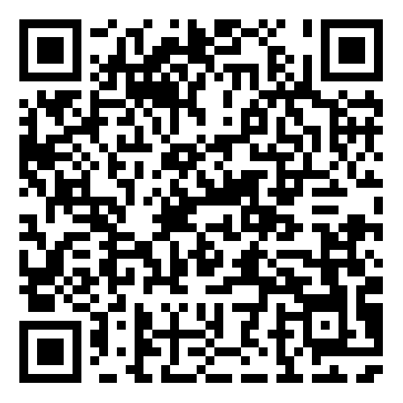
This work is supported by the generosity of the FHS Sponsoring Institutions
For a full list visit
https://www.fetalheartsociety.org/i4a/pages/index.cfm?pageid=3361
or scan the QR code
The Fetal Heart Society, a 501(c)(3) nonprofit organization, is dedicated to advancing fetal cardiovascular care and science through collaborative research, education, and mentorship

Slide 6
For ultrasound images

Slide 7
Other things that need a dark background

Slide 8
www.fetalheartsociety.org

