Slide 1

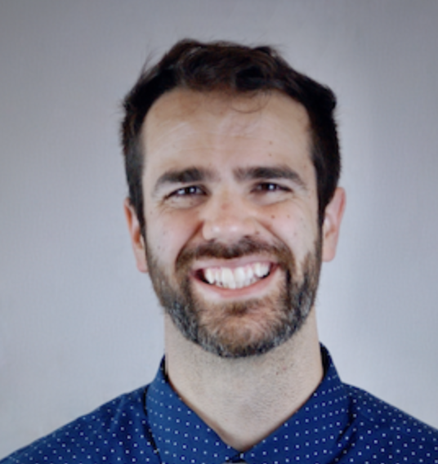
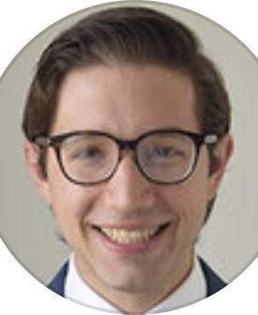
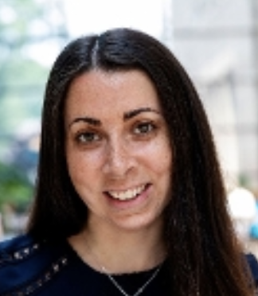
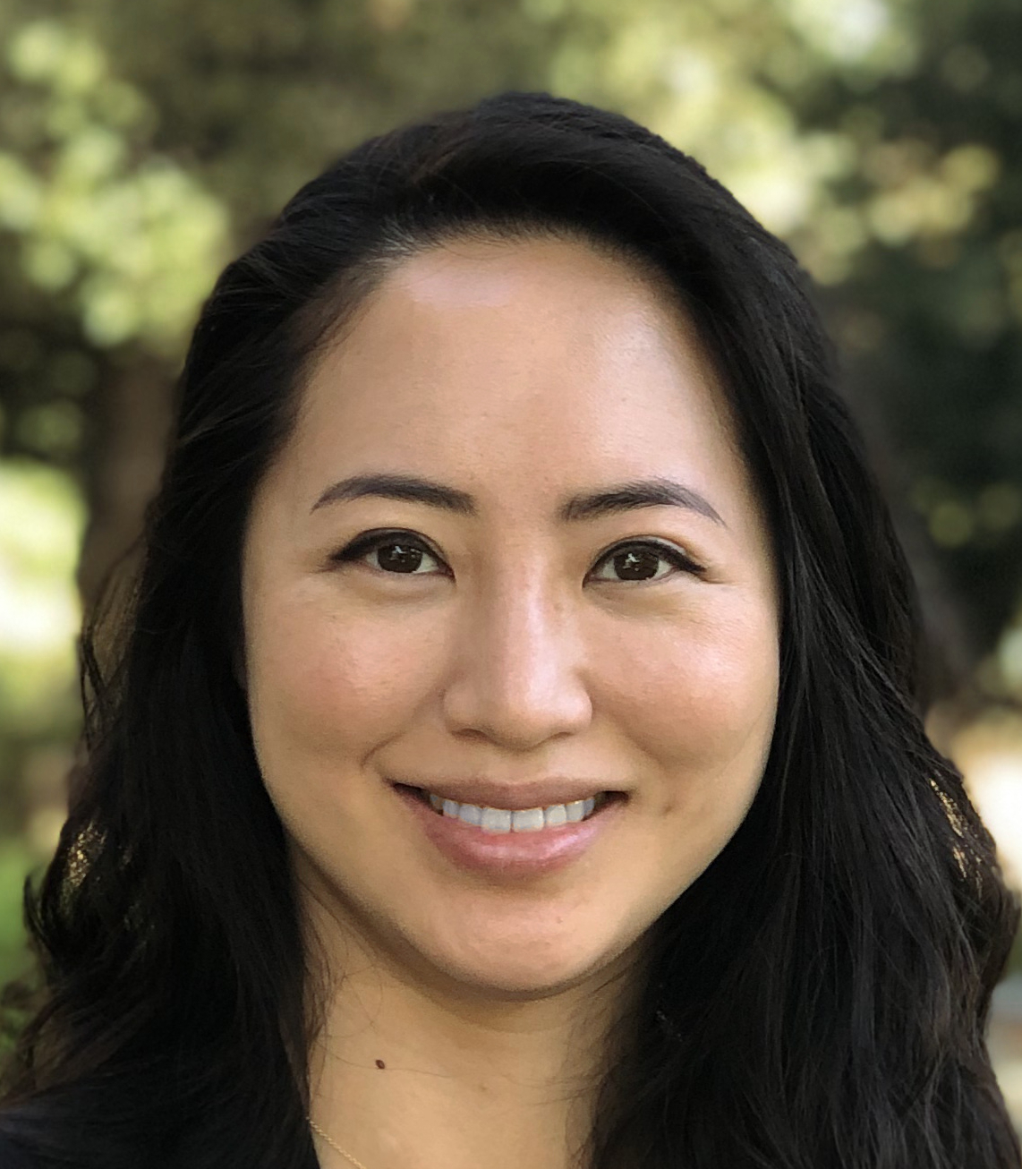
Case Presenters
Speakers
R
https://fetalheartsociety.org
Aaron Phillips, MD
Advanced Imaging Fellow,
Pediatric Cardiology
Lucile Packard Children’s Hospital at Stanford
David Barris , MD
Advanced Imaging Fellow,
Pediatric Cardiology
Mount Sinai Kravis Children’s Hospital
Fetal Heart Society presents:
Jennifer Cohen, MD
Director of Pediatric/Congenital CT
Mount Sinai Kravis Children’s Hospital
Diagnostic and Management Challenges of Congenitally Corrected TGA
Thursday, December 14 , 2023
17:30 Los Angeles 20:30 New York 01:30 December 15 London
A FREE one hour educational webinar.
The session will be recorded and available for viewing on the FHS website.
Deborah Ho, MD
Director, Complex Biventricular Reconstruction Program
Lucile Packard Children’s Hospital at Stanford
Register at: https://tinyurl.com/34cnd9zu

